Slide 1
1. Introduction
1.5. The Operating System Concepts

Slide 2
Processes (1)
Key concept in all operating systems
Definition: a program in execution
Process is associated with an address space
Also associated with set of resources
Process can be thought of as a container
  Holds all information needed to run program
Tanenbaum & Bos, Modern Operating Systems: 4th ed., Global Edition (c) 2015 Pearson Education Limited. All rights reserved.

Slide 3
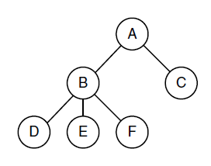
Processes (2)
Figure 1-13. A process tree. Process A created two child processes, B and C. Process B created three child processes, D, E, and F.
Tanenbaum & Bos, Modern Operating Systems: 4th ed., Global Edition (c) 2015 Pearson Education Limited. All rights reserved.

Slide 4
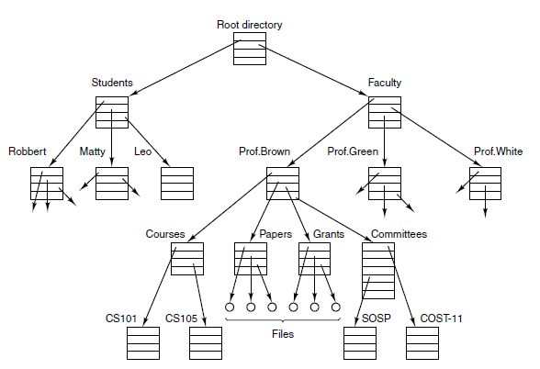
Files (1)
Figure 1-14. A file system for a university department.
Tanenbaum & Bos, Modern Operating Systems: 4th ed., Global Edition (c) 2015 Pearson Education Limited. All rights reserved.

Slide 5
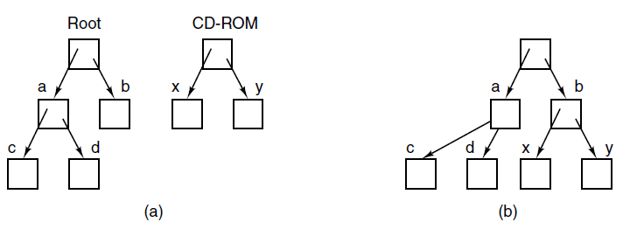
Files (2)
Figure 1-15. (a) Before mounting, the files on the CD-ROM are not accessible. (b) After mounting, they are part of the file hierarchy.
Tanenbaum & Bos, Modern Operating Systems: 4th ed., Global Edition (c) 2015 Pearson Education Limited. All rights reserved.

Slide 6
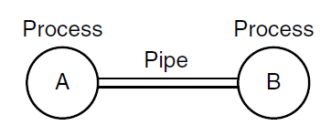
Pipe
Figure 1-16. Two processes connected by a pipe.
Tanenbaum & Bos, Modern Operating Systems: 4th ed., Global Edition (c) 2015 Pearson Education Limited. All rights reserved.

Slide 7
Ontogeny Recapitulates Phylogeny
Each new “species” of computer
  Goes through same development as “ancestors”
Consequence of impermanence
  Text often looks at “obsolete” concepts
  Changes in technology may bring them back
Happens with large memory, protection hardware, disks, virtual memory
Tanenbaum & Bos, Modern Operating Systems: 4th ed., Global Edition (c) 2015 Pearson Education Limited. All rights reserved.

Slide 8
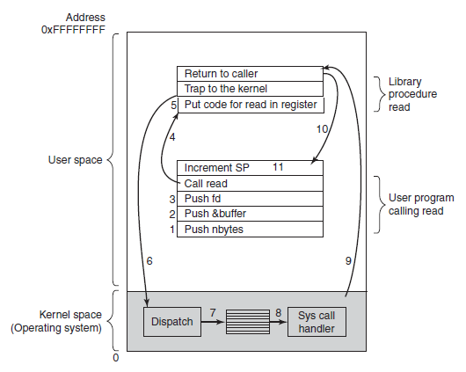
System Calls (1)
Figure 1-17. The 11 steps in making the system call
A call from a C program might look like this: read(fd, buffer, nbytes).
(Read nbytes from the file specified by fd into buffer. Return: How many bytes)
Tanenbaum & Bos, Modern Operating Systems: 4th ed., Global Edition (c) 2015 Pearson Education Limited. All rights reserved.

Slide 9
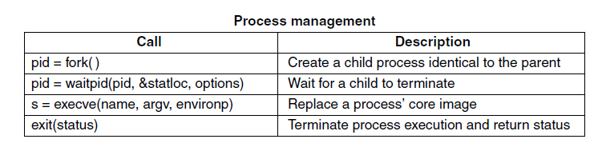
System Calls (2)
Figure 1-18. Some of the major POSIX system calls. The return code s is −1 if an error has occurred. The return codes are as follows: pid is a process id, fd is a file descriptor, n is a byte count, position is an offset within the file, and seconds is the elapsed time.
POSIX (Portable Operating System Interface) is a set of standard operating system interfaces based on the Unix.
Tanenbaum & Bos, Modern Operating Systems: 4th ed., Global Edition (c) 2015 Pearson Education Limited. All rights reserved.

Slide 10
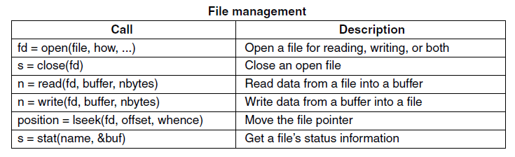
System Calls (3)
Figure 1-18. Some of the major POSIX system calls. The return code s is −1 if an error has occurred. The return codes are as follows: pid is a process id, fd is a file descriptor, n is a byte count, position is an offset within the file, and seconds is the elapsed time.
Tanenbaum & Bos, Modern Operating Systems: 4th ed., Global Edition (c) 2015 Pearson Education Limited. All rights reserved.

Slide 11
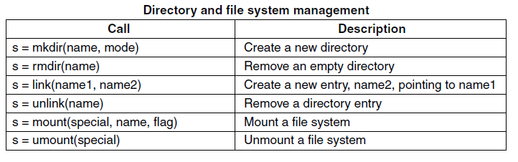
System Calls (4)
Figure 1-18. Some of the major POSIX system calls. The return code s is −1 if an error has occurred. The return codes are as follows: pid is a process id, fd is a file descriptor, n is a byte count, position is an offset within the file, and seconds is the elapsed time.
Tanenbaum & Bos, Modern Operating Systems: 4th ed., Global Edition (c) 2015 Pearson Education Limited. All rights reserved.

Slide 12
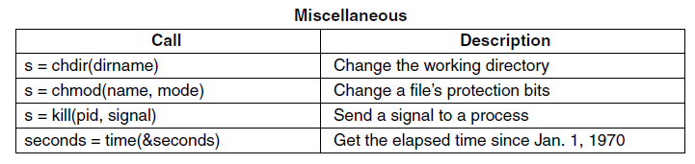
System Calls (5)
Figure 1-18. Some of the major POSIX system calls. The return code s is −1 if an error has occurred. The return codes are as follows: pid is a process id, fd is a file descriptor, n is a byte count, position is an offset within the file, and seconds is the elapsed time.
Tanenbaum & Bos, Modern Operating Systems: 4th ed., Global Edition (c) 2015 Pearson Education Limited. All rights reserved.

Slide 13
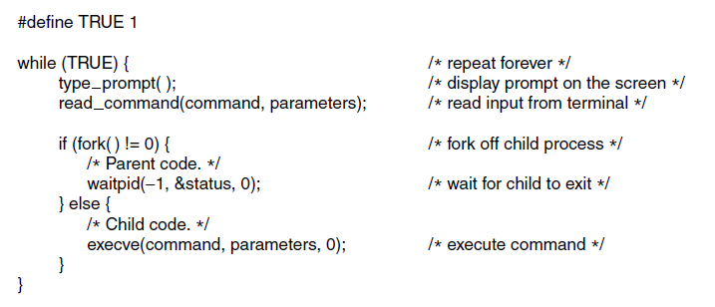
System Calls for Process Management
Figure 1-19. A stripped-down shell. Throughout this book, TRUE is assumed to be defined as 1.
Tanenbaum & Bos, Modern Operating Systems: 4th ed., Global Edition (c) 2015 Pearson Education Limited. All rights reserved.

Slide 14
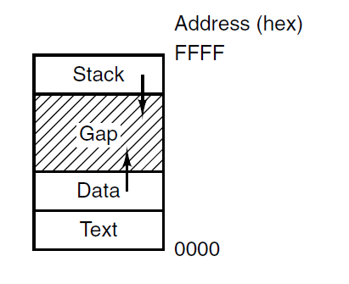
System Calls for File Management
Figure 1-20. Processes have three segments:
text, data, and stack
Tanenbaum & Bos, Modern Operating Systems: 4th ed., Global Edition (c) 2015 Pearson Education Limited. All rights reserved.

Slide 15
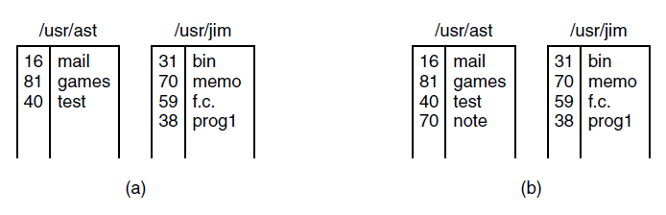
System Calls for Directory Management (1)
link("/usr/jim/memo", "/usr/ast/note");
Thereafter, /usr/jim/memo and /usr/ast/note refer to the same file.
Figure 1-21. (a) Two directories before linking usr/jim/memo to ast’s directory. (b) The same directories after linking.
Tanenbaum & Bos, Modern Operating Systems: 4th ed., Global Edition (c) 2015 Pearson Education Limited. All rights reserved.

Slide 16
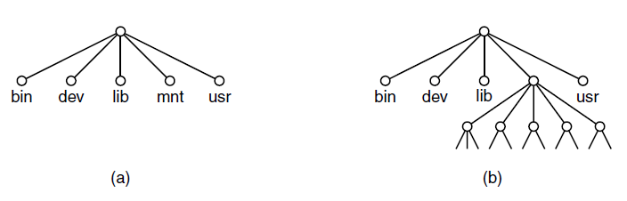
System Calls for Directory Management (2)
Figure 1-22. (a) File system before the mount.
(b) File system after the mount.
Tanenbaum & Bos, Modern Operating Systems: 4th ed., Global Edition (c) 2015 Pearson Education Limited. All rights reserved.

Slide 17
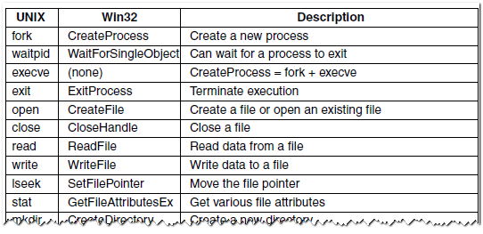
The Windows Win32 API (1)
Figure 1-23. The Win32 API calls that roughly correspond to the UNIX calls of Fig. 1-18.
Tanenbaum & Bos, Modern Operating Systems: 4th ed., Global Edition (c) 2015 Pearson Education Limited. All rights reserved.

Slide 18
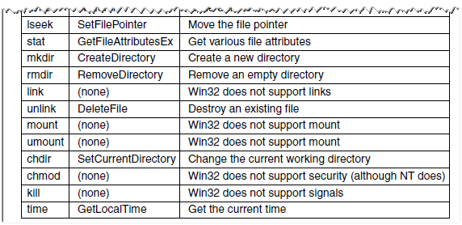
The Windows Win32 API (2)
Figure 1-23. The Win32 API calls that roughly correspond to the UNIX calls of Fig. 1-18.
Tanenbaum & Bos, Modern Operating Systems: 4th ed., Global Edition (c) 2015 Pearson Education Limited. All rights reserved.

Slide 19
Monolithic and Microkernel
Traditional monolithic kernels: Implements all operating system services in kernel space.
A microkernel is a type of operating system kernel that is designed to provide only the most basic services required for an operating system to function, such as memory management and process scheduling. Other services, such as device drivers and file systems, are implemented as user-level processes that communicate with the microkernel via message passing. This design allows the operating system to be more modular and flexible than traditional monolithic kernels, which implement all operating system services in kernel space.
Tanenbaum & Bos, Modern Operating Systems: 4th ed., Global Edition (c) 2015 Pearson Education Limited. All rights reserved.

Slide 20
Monolithic Systems (1)
Basic structure of OS
A main program that invokes the requested service procedure.
A set of service procedures that carry out the system calls.
A set of utility procedures that help the service procedures.
Tanenbaum & Bos, Modern Operating Systems: 4th ed., Global Edition (c) 2015 Pearson Education Limited. All rights reserved.

Slide 21
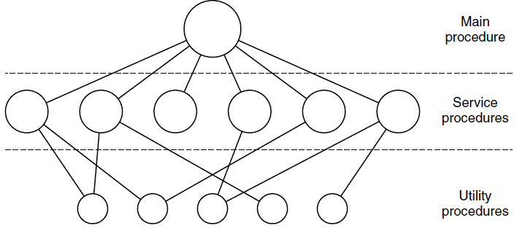
Monolithic Systems (2)
Figure 1-24. A simple structuring model
for a monolithic system.
Tanenbaum & Bos, Modern Operating Systems: 4th ed., Global Edition (c) 2015 Pearson Education Limited. All rights reserved.

Slide 22
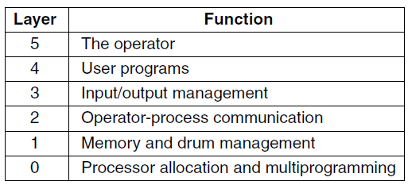
Layered Systems
Figure 1-25. Structure of the THE operating system.
Tanenbaum & Bos, Modern Operating Systems: 4th ed., Global Edition (c) 2015 Pearson Education Limited. All rights reserved.

Slide 23
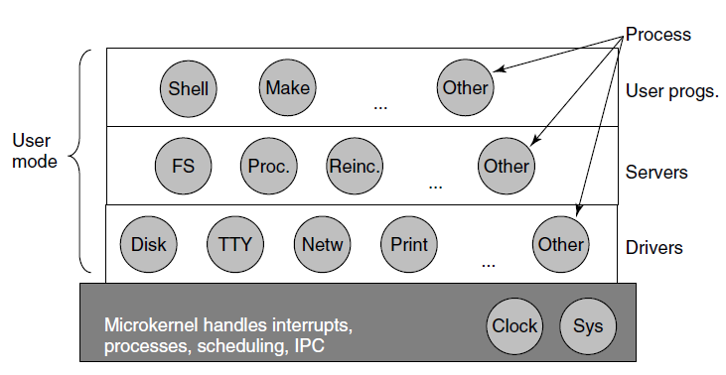
Microkernels
Figure 1-26. Simplified structure of the
MINIX 3 system.
Tanenbaum & Bos, Modern Operating Systems: 4th ed., Global Edition (c) 2015 Pearson Education Limited. All rights reserved.

Slide 24
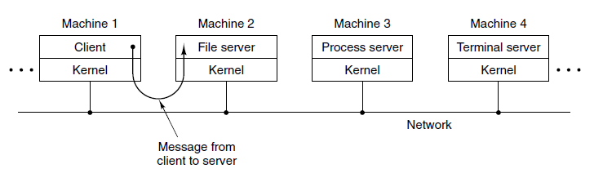
Client-Server Model
Figure 1-27. The client-server model over a network.
Tanenbaum & Bos, Modern Operating Systems: 4th ed., Global Edition (c) 2015 Pearson Education Limited. All rights reserved.

Slide 25
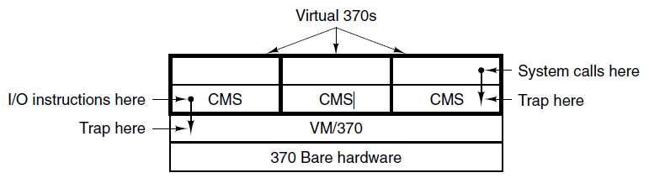
Virtual Machines
Figure 1-28. The structure of VM/370 with CMS.
VM/370, released in 1972, is an IBM's System/370 reimplementation of earlier CP/CMS operating system.
The Conversational Monitor System (CMS) is a simple interactive single-user operating system. CMS runs as a "guest" operating system in a private virtual machine created by the VM control program. The control program plus CMS together create a multi-user time-sharing operating system.
Tanenbaum & Bos, Modern Operating Systems: 4th ed., Global Edition (c) 2015 Pearson Education Limited. All rights reserved.

Slide 26
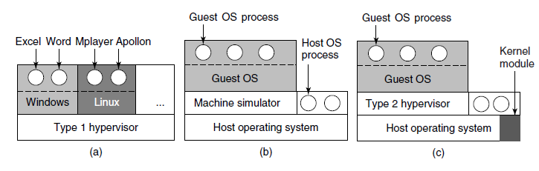
Virtual Machines Rediscovered
Figure 1-29. (a) A type 1 hypervisor. (b) A pure type 2 hypervisor. (c) A practical type 2 hypervisor.
Tanenbaum & Bos, Modern Operating Systems: 4th ed., Global Edition (c) 2015 Pearson Education Limited. All rights reserved.

Slide 27
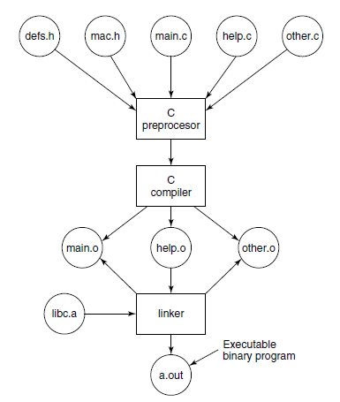
Large Programming Projects
Figure 1-30. The process of compiling C and header
files to make an executable.
Tanenbaum & Bos, Modern Operating Systems: 4th ed., Global Edition (c) 2015 Pearson Education Limited. All rights reserved.

Slide 28
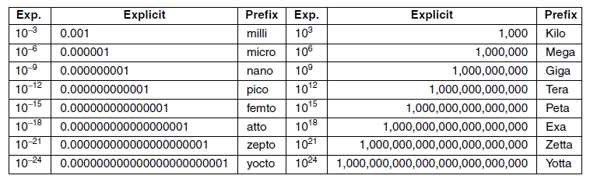
Metric Units
Figure 1-31. The principal metric prefixes.
Tanenbaum & Bos, Modern Operating Systems: 4th ed., Global Edition (c) 2015 Pearson Education Limited. All rights reserved.

Slide 29
End
Chapter 1
Tanenbaum & Bos, Modern Operating Systems: 4th ed., Global Edition (c) 2015 Pearson Education Limited. All rights reserved.

